Slide 1
CALS Redesign

Slide 2
Rationale
Reduce administrative burden
Grow enrollments in academic programs
Encourage interdisciplinary collaborations
Increase faculty and student numbers
Notes:
Reduce the administrative and service burdens wherever possible so that faculty and staff have more time to focus on teaching, research and outreach.
Grow enrollments in our academic programs – particularly our undergraduate programs and professional offerings like short courses, certificates and master’s degrees.
Create structures that foster the interdisciplinary collaborations needed to solve the greatest challenges facing animal and human well-being; enhancing food production while maintaining clean water and healthy soil
Our faculty and student numbers have decreased in recent years. Finding creative ways to increase both populations will ensure a healthy future for CALS.

Slide 3
Addressing Chancellor
Blank’s priorities
Expand summer semester
Grow programs for professionals
Set market-based tuition
Explore student mix & numbers
Grow alumni support
Grow research funds
Notes:
References to these revenue growth strategies can be found in the Chancellor’s July 20, 2018 blog post: https://chancellor.wisc.edu/blog/reflections-on-five-years/

Slide 4
CALS goals
Increase enrollment by 25% over five years
Grow non-traditional programs
Advance research excellence
Grow faculty numbers by 10% over 5 years numbers

Slide 5
Core activities will remain the same
Remain true to signature strengths and key partnerships
Individual faculty will continue to lead labs investigating a variety of research questions
CALS students will continue to have beyond-classroom experiences:
  internships, research opportunities, study abroad, capstone courses, honors programs
Continue to support Wisconsin agriculture and natural resources through applied research and outreach

Slide 6
Expected changes
Many departments will merge or form a partnership a “collaborative”
Fewer majors, but more options within majors
  Smaller enrollment majors could evolve into curriculum in new programs or be an “option” within a major
  Create 2-3 new majors to meet student and societal demands in the coming years

Slide 7
Redesign metrics
Size of faculty
Total budget
Grant expenditures
Grant expenditures ÷ total budget
Student credit hours
Student credit hours ÷ 101 dept. budget
Undergraduate degrees by program
Fall undergraduate enrollment
Notes:
Faculty size = indicates overall workload for service. Too few results in too much work per faculty member
Total budget = just as it sounds
Grant expenditures reflect research volume, especially from extramural funds
Grant expenditures by budget, reflects ROI for research activity
Student credit hours = total number of credits taught (100 students in a 3 credit course = 300 student credit hours)
Student credit hours ÷ 101 budget reflects ROI for tuition investment in that department
Degrees reflect upper level student majors the department is advising. The final years of a program are more intensive for the faculty and staff in that program because the students are getting more specialized training and advising
Enrollment is full number of majors in any class year

Slide 8
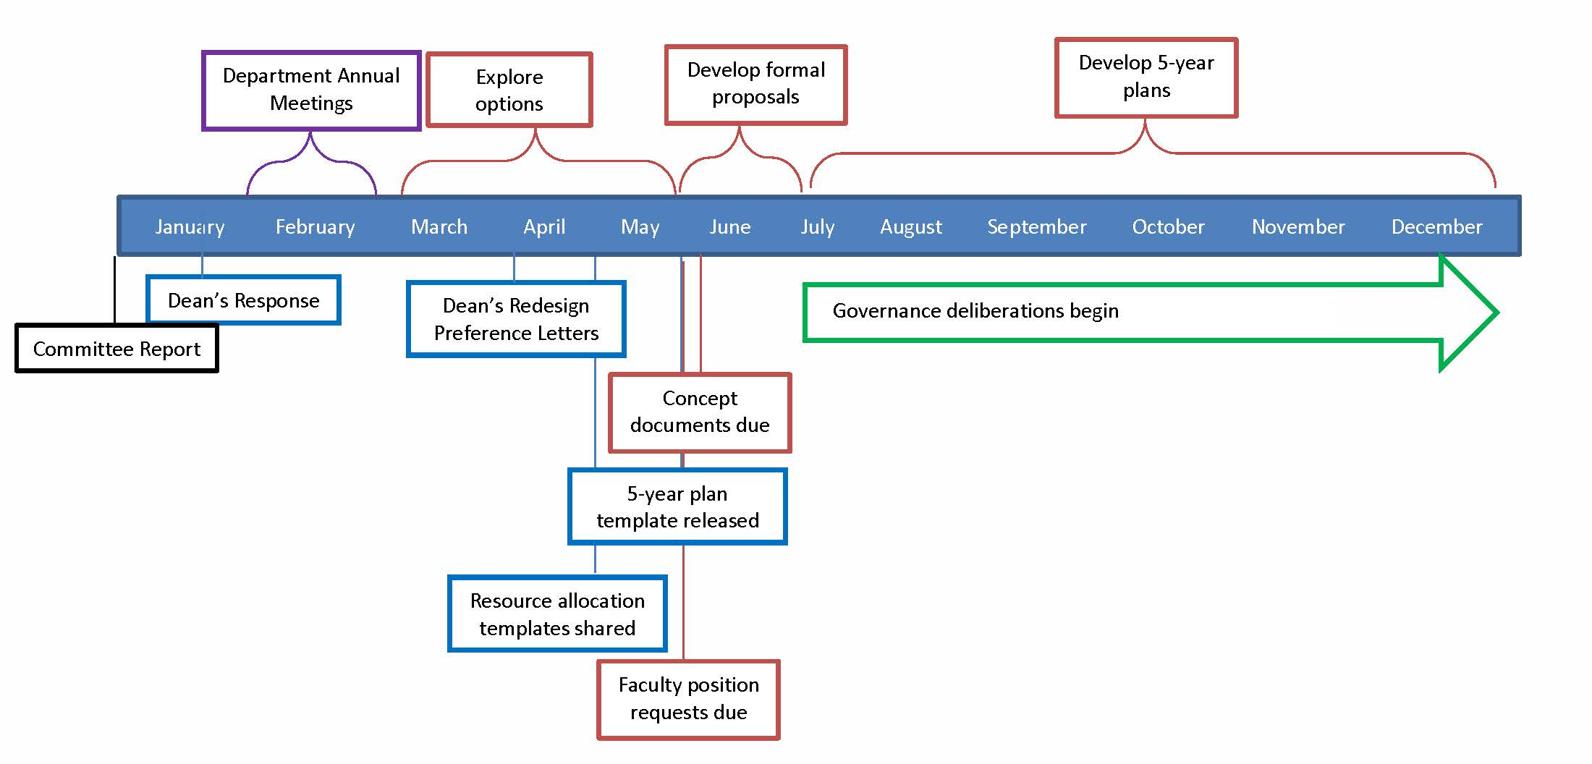
Implementation timeline

Slide 9
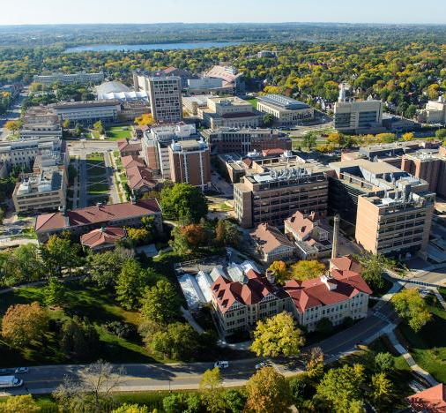
CALS stats
17 academic departments
  Agriculture
  Food & nutrition
  Natural resources & the environment
  Basic life sciences
226 faculty
>4,200 students
  3,239 undergraduates
  836 graduate students
  100 FISC students
~45,000 living alumni
Notes:
About ¼ of faculty have extension appointments.
In addition to the life sciences, our faculty expertise spans physical and social sciences as well.

Slide 10
CALS faculty FTE
LA/URPL
move to L&S
11 FTE
Notes:
We’ve declined by about 10% over a decade. However, departures have not happened uniformly.
Example – Extention FTEs down to 52 from 56 in one year, specific departments and programs also unevenly impacted.

Slide 11
Faculty demographics: CALS vs. UW
CALS Faculty loss is 33.4% since 1980
UW Faculty loss is 10.2% during the same period
Since 2000, CALS faculty loss is 3x that of UW

Slide 12
CALS faculty projected to 2045
With no additional investment, and assuming similar annual expenditures for retention and promotion, CALS faculty numbers will decline by approx. 1.5 per year
By 2055, faculty numbers would be one half the level they were in 1980

Slide 13
Graduate Student Enrollments & Degrees
Enrollment and degrees = UW-Madison Data Digest
Except 2016 degrees and enrollment = Registrar’s 10th day of class reports and rolling degree reports

Slide 14
Undergraduate enrollments & degrees
Enrollment and degrees = UW-Madison Data Digest
Except 2015-16 degrees and 2016-17 enrollment = Registrar’s rolling degree reports and
10th day of class reports
Notes:
Source of data for years 2006-2015 – Data Digest. 2017 based on 10th class day enrollment from John Klatt.

Slide 15
Undergrad degrees granted per program
(average 2011-2016)
Notes:
CALS supports a wide diversity of undergraduate programs. Some large, some small; Some interdisciplinary/interdepartmental, some departmentally focused. What are the implications?
Chancellor Blank has said that we have too many small programs, suggesting that we need to redirect some of our efforts.
We have a need to serve large, interdepartmental programs such as biology, environmental sciences and the global health certificate.
We need to be attentive to evolving student needs and opportunities that these provide to the college.

Slide 16
CALS Research Expenditures
Average expenditures = $112 M (not including GLBRC)

Slide 17
Budget change
5% distributed by formula
10% funding distributed by formula
-$203,847
-$388,470
Notes:
State funds for CALS have been declining
--Budget cuts to UW reduced CALS 101 by $2.8 M in FY16 and 17
CALS 101 also decreased due to campus budget model metrics
--Decrease in 2016 by $100,000
--Decrease in 2017 by $200,000
Net result: fewer funds for salary reinvestment

Slide 18
Organizational Redesign
Committee report
January 2018
Recommendations on:
Overall collegiate structure
New resource allocation model
Performance metrics
Five-year departmental plans
Notes:
Full committee report available online: https://orgredesign.cals.wisc.edu/wp-content/uploads/sites/27/2018/01/CALS-Organizational-Redesign-Committee-Recommendations-FINAL-1.pdf

Slide 19
Report: Resource allocation
Split faculty salary savings
  50% returned to college
  50% remains in department
Prior practice
  100% returned to college
  Internal competition to request funds for new/replacement faculty positions
Notes:
Full committee report available online: https://orgredesign.cals.wisc.edu/wp-content/uploads/sites/27/2018/01/CALS-Organizational-Redesign-Committee-Recommendations-FINAL-1.pdf

Slide 20
Report: Performance metrics
Research
Teaching
Extension/outreach
Service contributions
Diversity and climate
Notes:
Full committee report available online: https://orgredesign.cals.wisc.edu/wp-content/uploads/sites/27/2018/01/CALS-Organizational-Redesign-Committee-Recommendations-FINAL-1.pdf

Slide 21
Report: Structure
Hybrid approach
  Departmental mergers
  Department collaboratives
Notes:
Full committee report available online: https://orgredesign.cals.wisc.edu/wp-content/uploads/sites/27/2018/01/CALS-Organizational-Redesign-Committee-Recommendations-FINAL-1.pdf

Slide 22
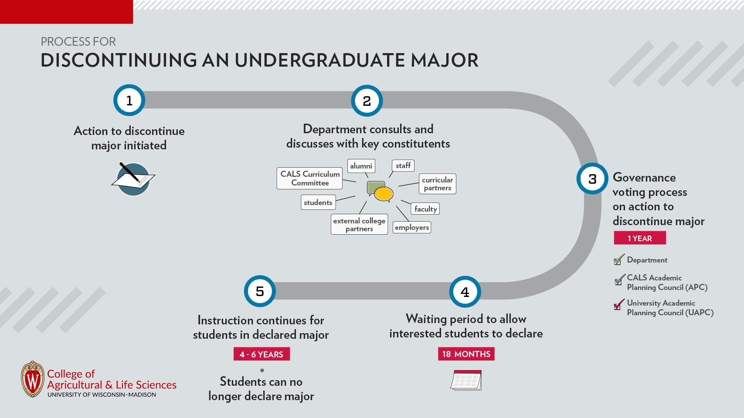
Process for discontinuing an undergraduate major

Slide 23
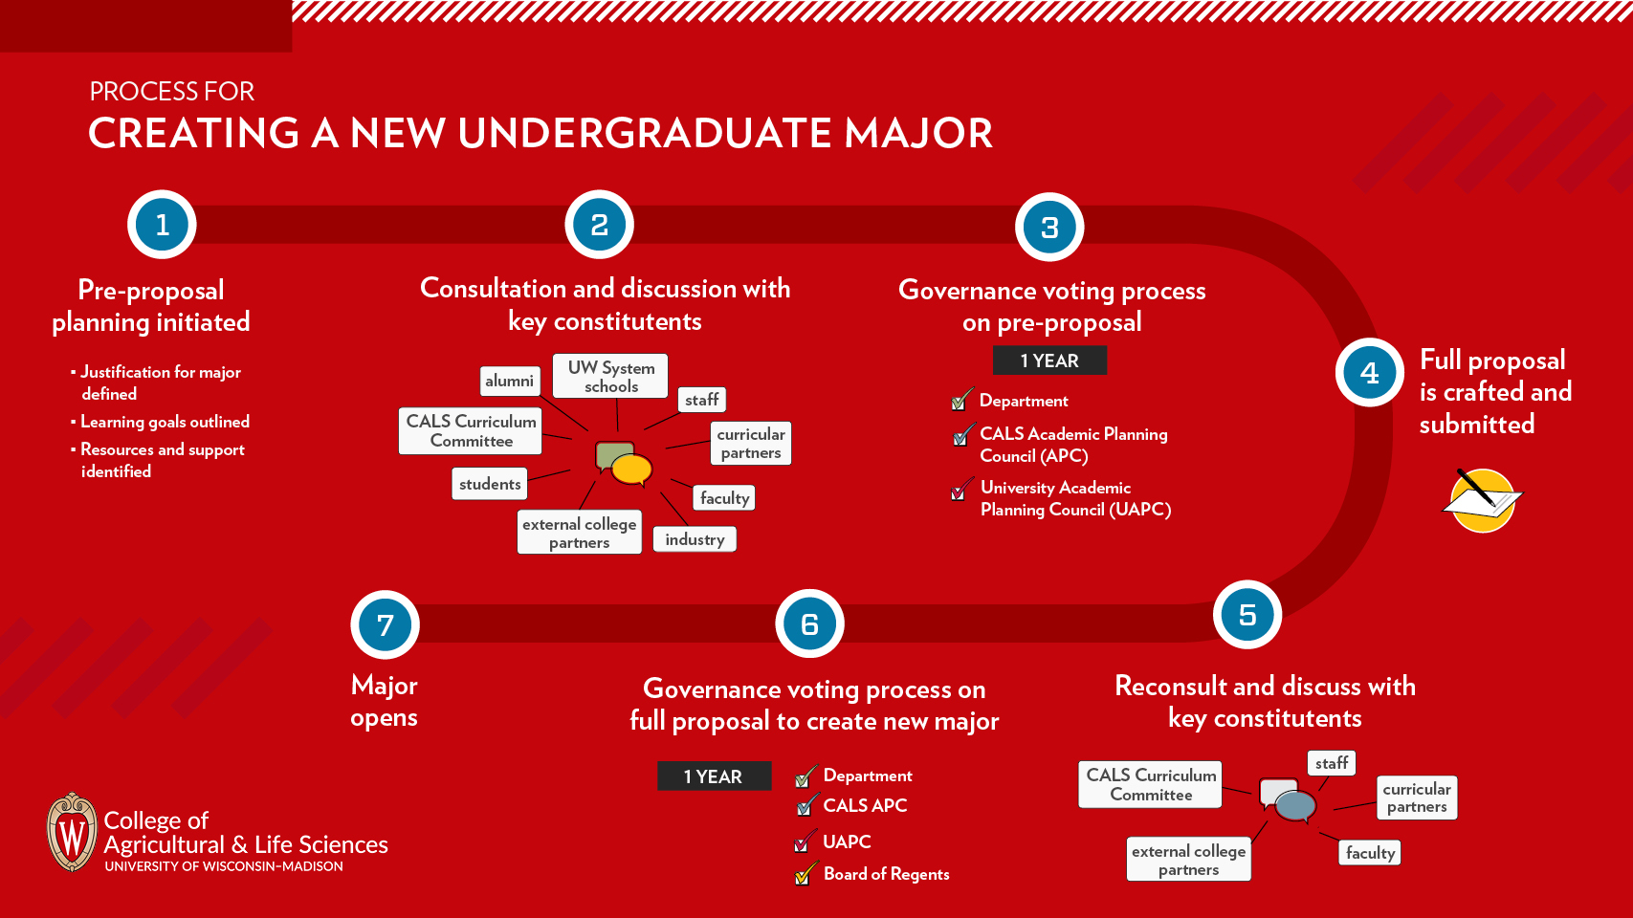
Process for creating an undergraduate major

